Slide 1

Enginius
Panel Regression
Minder Chen, CSU Channel Islands
Copyright (c) 2022, DecisionPro Inc.

Slide 2
Panel Regression Input Data
Replication or
Time Variable
(Month)
Target/
Dependent
Variable
Panel Variable (ID)
ID | Keyword | Campaign | Impressions | Clicks | Conversions | Cost | Avg Position
1 | office star | 1 | 121956 | 2674 | 107 | 6,012.00 | 1
2 | office star | 2 | 128464 | 2233 | 88 | 5,139.00 | 1
3 | office star | 3 | 157355 | 3734 | 101 | 5,170.00 | 1.1
4 | office star | 4 | 129973 | 3536 | 117 | 5,878.00 | 1
5 | office star | 5 | 149434 | 3251 | 102 | 4,877.00 | 1
6 | office star | 6 | 139025 | 3354 | 78 | 4,469.00 | 1
7 | office star | 7 | 173001 | 3869 | 123 | 5,825.00 | 1
8 | office star | 8 | 164582 | 5047 | 80 | 7,398.00 | 1.112
9 | office star | 9 | 149489 | 4575 | 150 | 6,312.00 | 1
10 | office star | 10 | 132480 | 4344 | 117 | 5,701.00 | 1
11 | office star | 11 | 125699 | 2386 | 87 | 4,603.00 | 1
12 | office star | 12 | 129135 | 2290 | 43 | 4,940.00 | 1
13 | office star coupons | 1 | 39049 | 1988 | 7 | 3,174.00 | 1.241
14 | office star coupons | 2 | 54057 | 4457 | 35 | 11,204.00 | 1.306
There are 18 campaigns. Each campaign may use a different set of keywords.
Sometimes, only one keyword ➔ Imbalance Panel Data

Slide 3
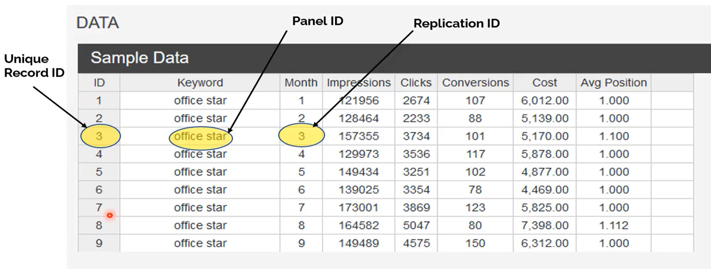
OfficeStar's Sample Data
(Entity)
(Multiple observations over time)

Slide 4
Keywords Used
office star
office star coupons
nearest office supplies store
best office supplies
bestbuy
office supplies
consumer electronics
laptop shop
nearest office store
my office star

Slide 5
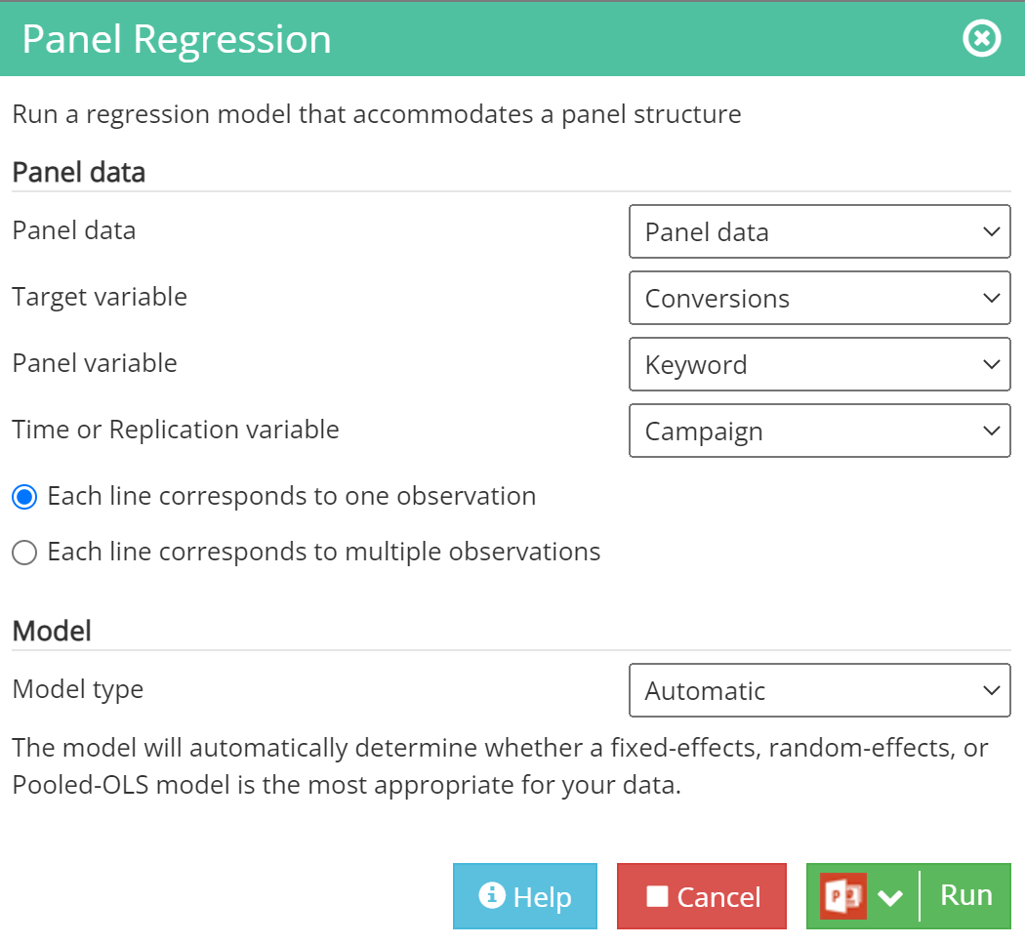
Run the
Panel Regression

Slide 6
Visualizing panel data

Slide 7
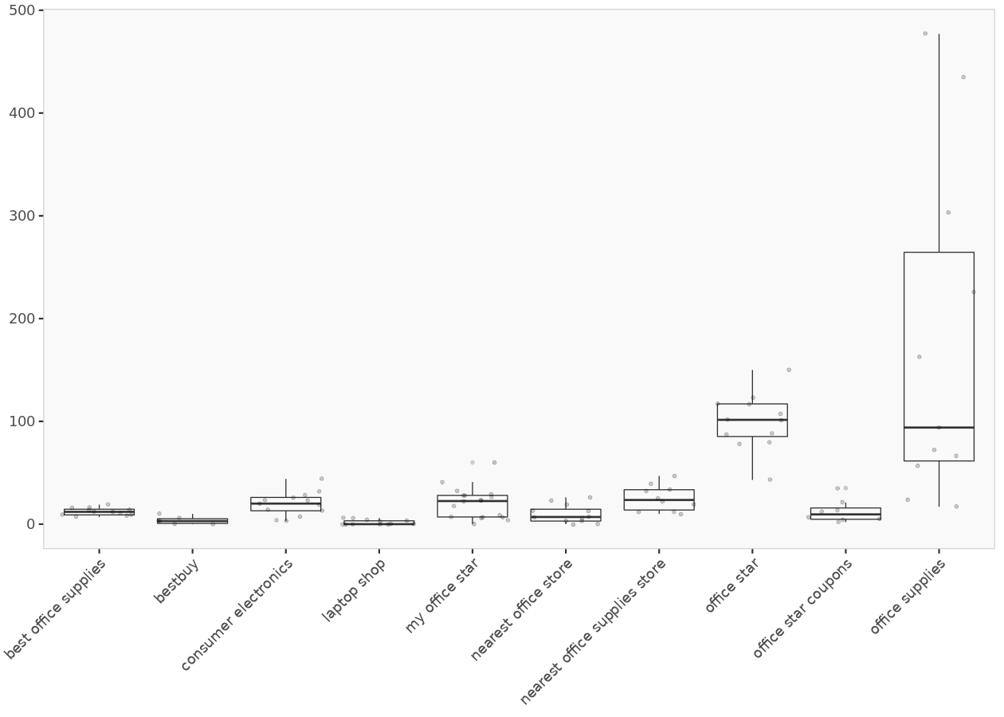
Box plot
These plots show the values of Conversions (y-axis) for different Panel-IDs, and are useful for identifying outliers. If a point falls outside the range of the whiskers, it needs to be examined more closely to assess whether it is due to data error or whether the point is truly an outlier. The plots may not show the entire range of X and Y values.

Slide 8
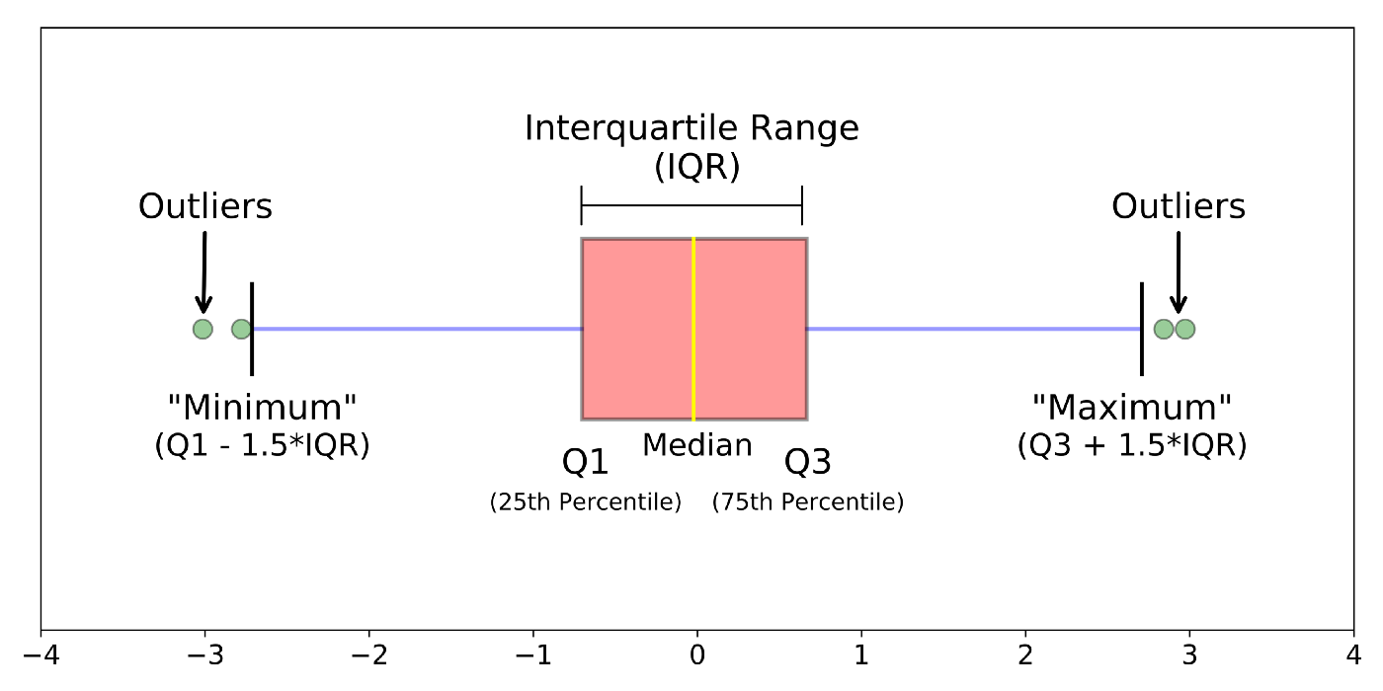
Boxplot (Whisker) Plot
Boxplots are a standardized way of displaying the distribution of data based on a five number summary (“minimum”, first quartile (Q1), median, third quartile (Q3), and “maximum”). Whiskers (shown in blue) outliers (shown as green circles)
https://towardsdatascience.com/understanding-boxplots-5e2df7bcbd51

Slide 9
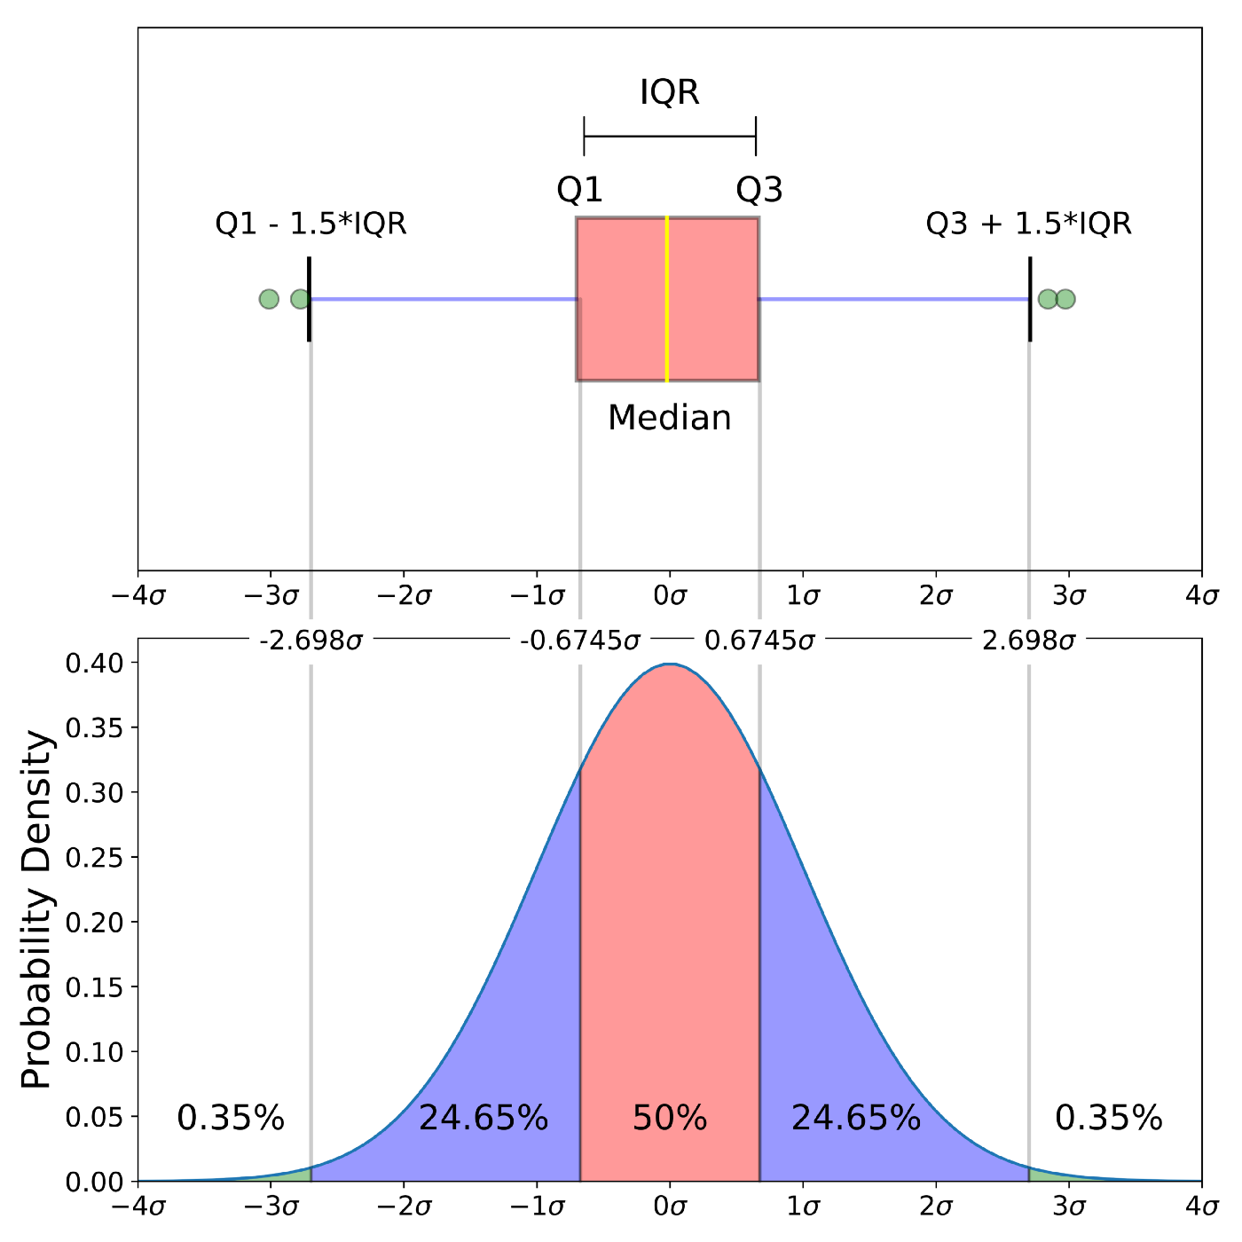
Boxplot vs. Normal Distribution
A comparison of a boxplot of a nearly normal distribution and the probability density function (pdf) for a normal distribution
Outliers are (for a normal distribution) .7% of the data.

Slide 10
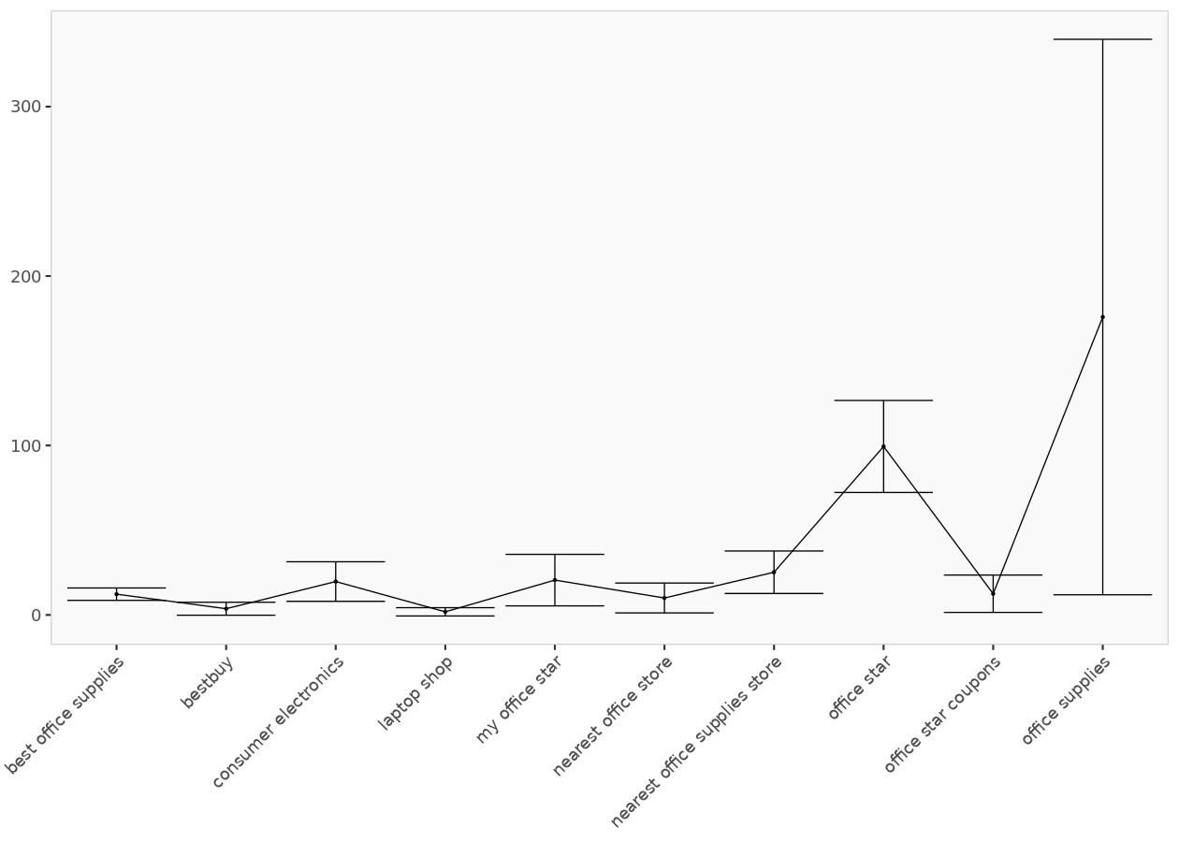
Heterogeneity across entities
I did this in Excel using Outline>Group
This can be done in Excel from the input data!
But the input data may need to be processed in Excel using Excel list's aggregate functions (e.g., min, max, avg) for Group.
Simple Min Max and Average Chart in Excel
https://www.youtube.com/watch?v=F428IA1XDxA
Keyword | Conversions
best office supplies Average | 12.25
bestbuy Average | 3.67
consumer electronics Average | 19.69
laptop shop Average | 1.83
my office star Average | 20.56
nearest office store Average | 10
nearest office supplies store Average | 25.2
office star Average | 99.42
office star coupons Average | 12.5
office supplies Average | 175.82
Grand Average | 38.74
This plot shows how the mean of Conversions varies between different entities (Panel IDs) [over Keyword]. The plots may not show the entire range of X and Y values.

Slide 11
FIXED-EFFECTS MODEL (Covariance Model, Within Estimator, Individual Dummy Variable Model, Least Squares Dummy Variable Model)
Use fixed-effects (FE) whenever you are only interested in analyzing the impact of variables that vary over time. FE explore the relationship between predictor and outcome variables within an entity (country, person, company, etc.). Each entity has its own individual characteristics that may or may not influence the predictor variables (for example, being a male or female could influence the opinion toward certain issue; or the political system of a particular country could have some effect on trade or GDP; or the business practices of a company may influence its stock price). When using FE we assume that something within the individual may impact or bias the predictor or outcome variables and we need to control for this. This is the rationale behind the assumption of the correlation between entity’s error term and predictor variables. FE remove the effect of those time-invariant characteristics so we can assess the net effect of the predictors on the outcome variable. Another important assumption of the FE model is that those time-invariant characteristics are unique to the individual and should not be correlated with other individual characteristics. Each entity is different therefore the entity’s error term and the constant (which captures individual characteristics) should not be correlated with the others. If the error terms are correlated, then FE is no suitable since inferences may not be correct and you need to model that relationship (probably using random-effects), this is the main rationale for the Hausman test (presented later on in this document).
https://www.princeton.edu/~otorres/Panel101.pdf

Slide 12
RANDOM-EFFECTS MODEL (Random Intercept, Partial Pooling Model)
The rationale behind random effects model is that, unlike the fixed effects model, the variation across entities is assumed to be random and uncorrelated with the predictor or independent variables included in the model.
Random effects assume that the entity’s error term is not correlated with the predictors (ako independent variables) which allows for time-invariant variables to play a role as explanatory variables.
In random-effects you need to specify those individual characteristics that may or may not influence the predictor variables. The problem with this is that some variables may not be available therefore leading to omitted variable bias in the model.
RE allows to generalize the inferences beyond the sample used in the model.

Slide 13
Hausman test

Slide 14
Hausman Test
We use the Hausman test to choose between a random effects (RE) and a fixed effects (FE) specification for the panel data model if the pooled-OLS model is rejected.
The random effects model is the preferred option if both random effects and fixed effects models are appropriate for the data set.
The null hypothesis tested at this stage is that both the random effects and fixed effects models are appropriate for the data, and this hypothesis is tested via a chi-square statistic. If this hypothesis is rejected, only the fixed effects model would be appropriate for the data.
This plot summarizes the Pearson correlations computed from the variance covariance matrix of the estimated coefficients. Correlation between coefficients were obtained by dividing the covariance between each pair of coefficients by the product of their standard deviations. They range from 1 for perfectly correlated coefficients to -1 for perfectly negatively correlated coefficients. A value of 0 means the two estimated coefficients are not correlated.

Slide 15
Hausman Test
 | Chisq | p-value | df | Hypothesis
 | 1.71 | 0.788602 | 4 | Both FE and RE models are consistent
** Random Effects (RE) and a Fixed Effects (FE)
➔ Choose RE which is better!
For a Chi-square test, a p-value that is less than or equal to your significance level indicates there is sufficient evidence to conclude that the observed distribution is not the same as the expected distribution.
You can conclude that a relationship exists between the categorical variables.
Null hypothesis: There are no relationships between the categorical variables. If you know the value of one variable, it does not help you predict the value of another variable.
Alternative hypothesis: There are relationships between the categorical variables. Knowing the value of one variable does help you predict the value of another variable.
https://www.statisticshowto.com/hausman-test/
https://en.wikipedia.org/wiki/Durbin%E2%80%93Wu%E2%80%93Hausman_test

Slide 16
Random-effect model for Conversions

Slide 17
Model diagnostics
 | F-statistic | R-squared | p-value
Values | 662.110 | 0.860 | 0.000

Slide 18
Random Effects model summary
 | Coefficient | Standard deviation | t-value | p-value
Intercept | 7.77897 | 12.76197 | 0.60954 | 0.54216
Impressions | 0.00000 | 0.00000 | -1.92652 | 0.05404
Clicks | 0.00826 | 0.00089 | 9.26502 | 0.00000
Cost | 0.00213 | 0.00096 | 2.21728 | 0.02660
Avg_Position | 0.36506 | 2.90577 | 0.12563 | 0.90002
**If the p-value is larger than 0.05, we cannot conclude that a significant difference exists.
In these results, the relationships between conversion and clicks and Cost are statistically significant because the p-values for these terms are less than the significance level of 0.05. The relationship between conversion and Impressions and Avg-Position are not statistically significant at the significance level of 0.05.
https://support.minitab.com/en-us/minitab-express/1/help-and-how-to/modeling-statistics/regression/how-to/multiple-regression/interpret-the-results/key-results/

Slide 19
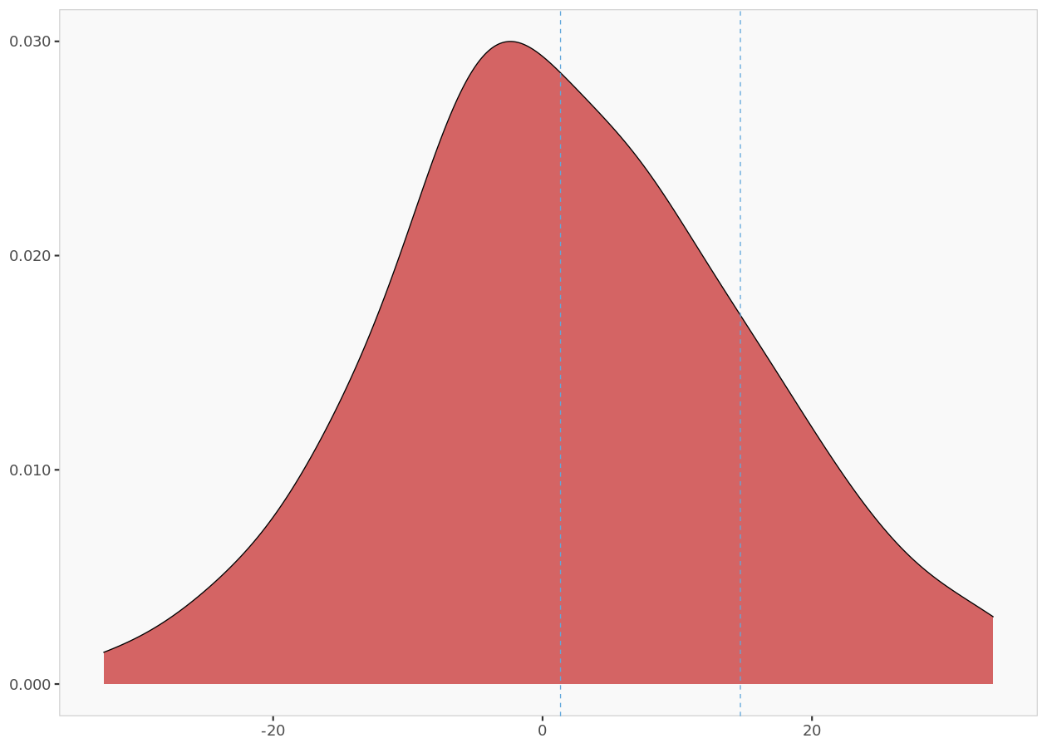
Random Effects
The plot shows the distribution of the random effects. The table displays the summary statistic of random effects.

Slide 20
Random effects summary
 | Minimum | 1st Quartile | Median | Mean | 3rd Quartile | Maximum
values | -30.15065 | -8.56345 | -2.14902 | 0.00000 | 1.97885 | 48.19746
The table displays the summary statistic of random effects.

Slide 21
Random effects coefficients
 | Coefficient
best office supplies | -7.8554
bestbuy | -8.7994
consumer electronics | 1.3070
laptop shop | -9.0017
my office star | 2.0425
nearest office store | -5.6051
nearest office supplies store | 1.7879
office star | 48.1975
office star coupons | -30.1507
office supplies | 8.0774
The random effects of the dependent variable, Conversions for each panel ID.

Slide 22
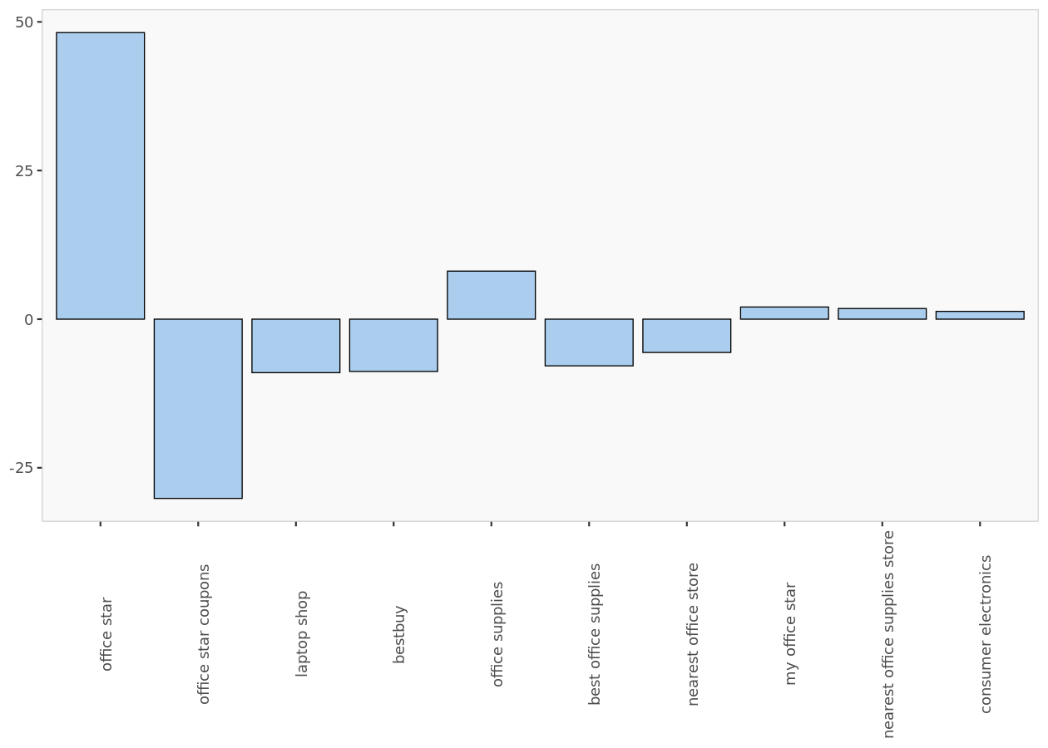
Plot of random effects
The coefficients of random effects are on the y-axis and
the Panel IDs (keywords) are on the x-axis

Slide 23
Correlation plot

Slide 24
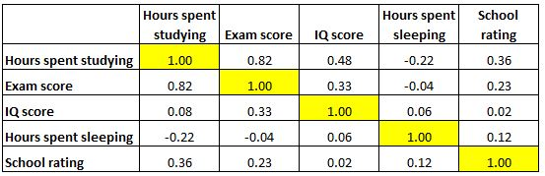
How to Read a Correlation Matrix
Pearson correlation coefficient is used to measure the linear association between two variables.
-1 indicates a perfectly negative linear correlation between two variables
0 indicates no linear correlation between two variables
1 indicates a perfectly positive linear correlation between two variables
https://www.statology.org/how-to-read-a-correlation-matrix/

Slide 25
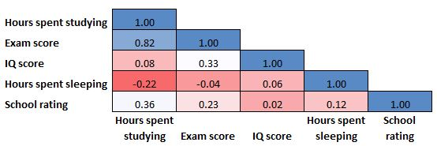
Correlation Matrix as a Heat Map
A correlation matrix is perfectly symmetrical.
Sometimes a correlation matrix will be colored in like a heat map to make the correlation coefficients even easier to read:

Slide 26
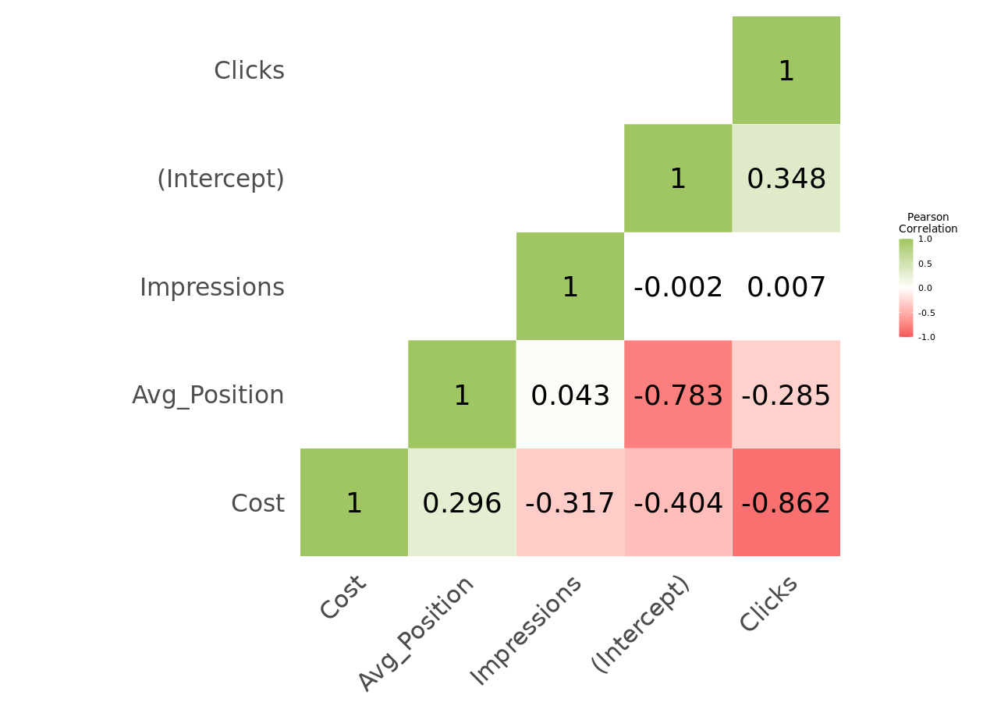
Correlation plot
https://www.statology.org/how-to-read-a-correlation-matrix/

